Slide 1
AUTOMATION PARKING SYSTEM
Progress report
Week 1

Slide 2
ESP32+ OV7670 FIFO prepare
Python environment setup
Progress – Week 1 →
Python backend & logics
MQTT Broker
SQLite Database
(Contains Logs and Data)

Slide 3
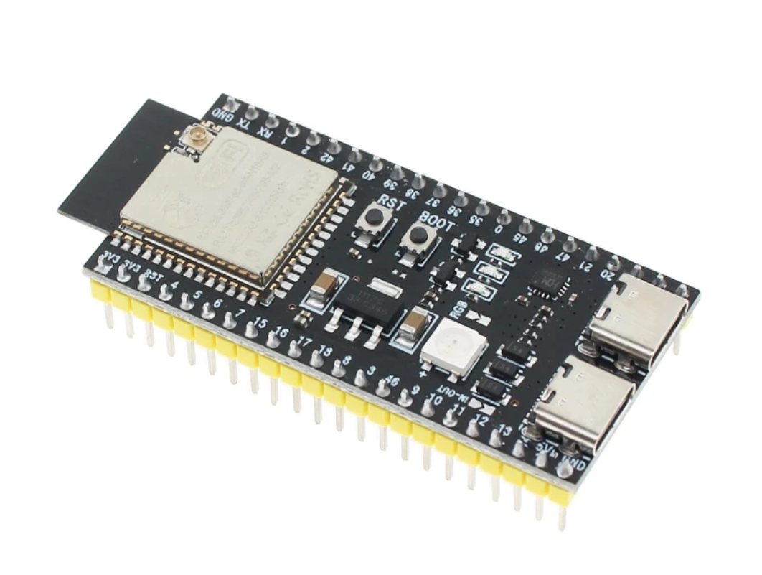
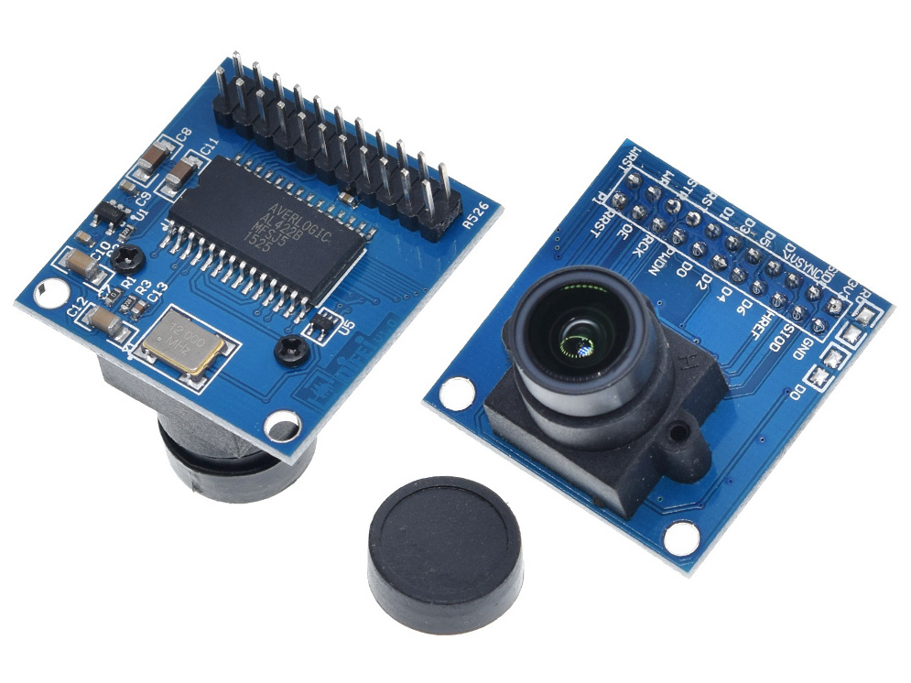
AUTOMATION PARKING SYSTEM Progress – Week 1
ESP32-CAM + Camera setup (OV7670 FIFO)
EPS32-S3 VROOM
OV7670 + FIFO
01 / 02

Slide 4
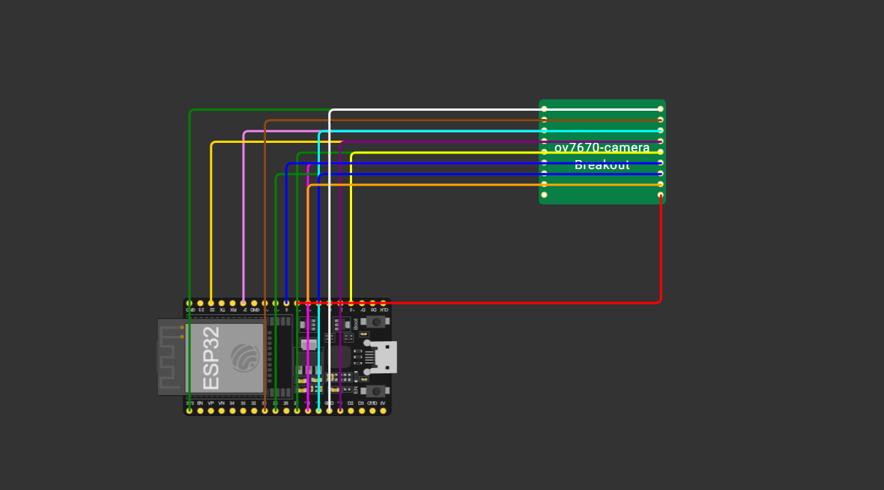
Progress – Week 1
ESP32-CAM + Camera setup (OV7670 FIFO)
Setup - Wiring
01 / 02

Slide 5
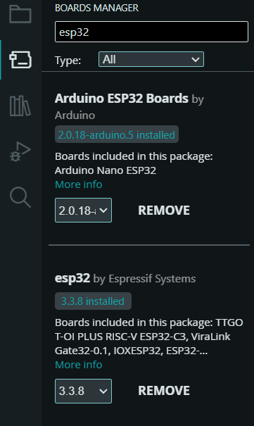
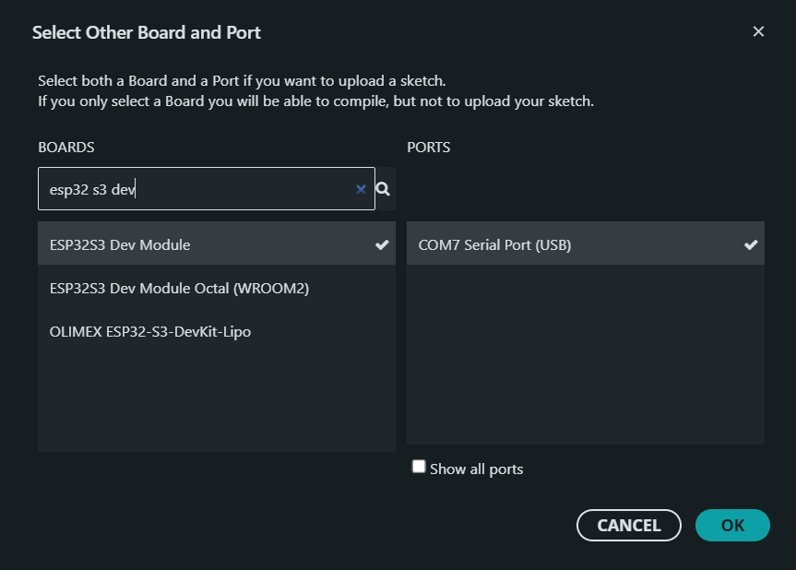
Progress – Week 1
ESP32-CAM + Camera setup (OV7670 FIFO)
Setup
01 / 02

Slide 6
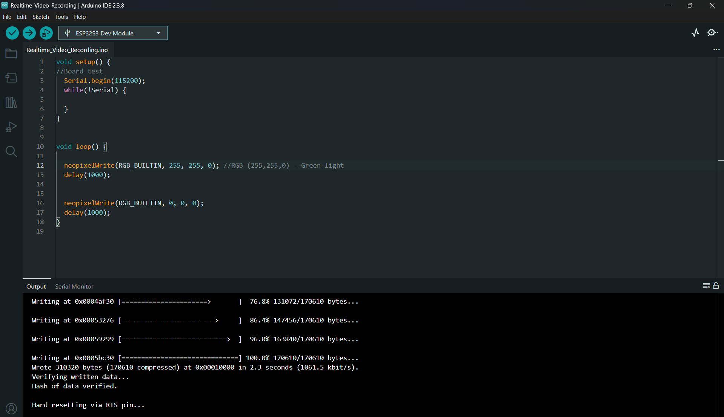
Progress – Week 1
ESP32-CAM + Camera setup (OV7670 FIFO)
Setup – board (simple test)
← Code push and board test
01 / 02

Slide 7
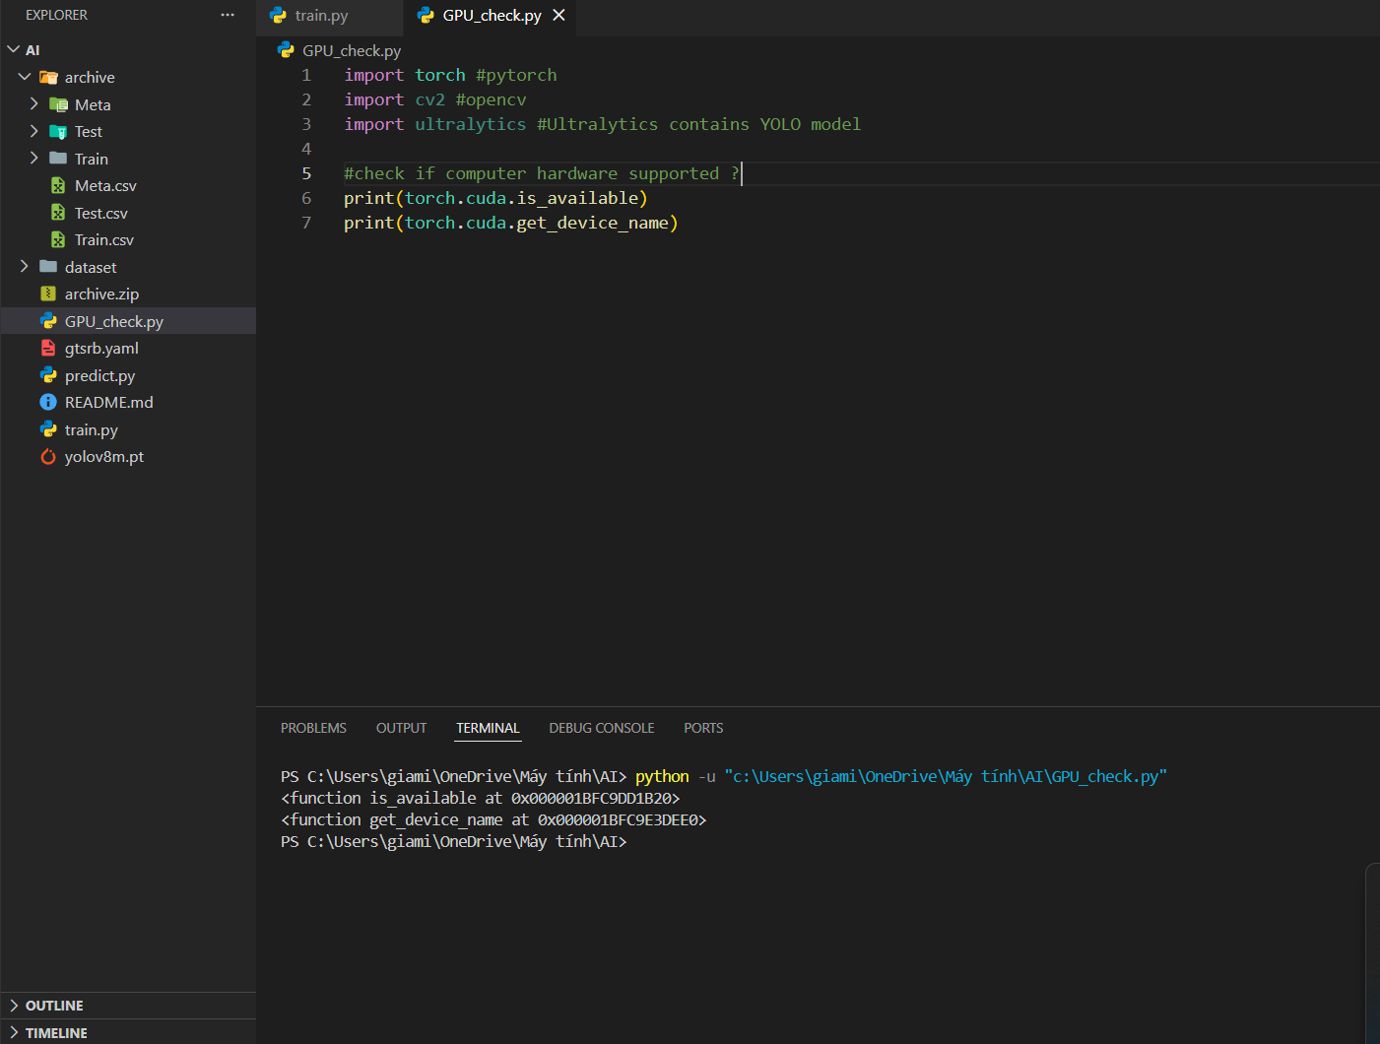
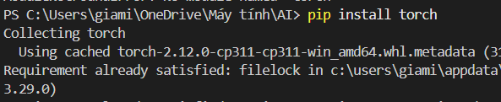
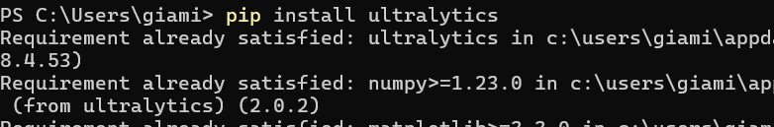
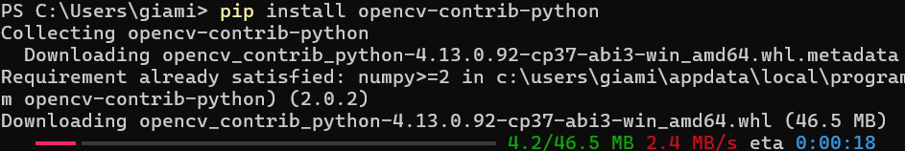
Progress – Week 1
Python environment
Setup environment and prepare
01 / 02

